Slide 1
Chapter 32
No-Arbitrage Models of the Short Rate

Slide 2
No-arbitrage Term Structure Models
A no-arbitrage model is a model designed to fit today’s term structure of interest rates

Slide 3
Developing No-Arbitrage
Model for r
A model for r can be made to fit the initial term structure by including a function of time in the drift

Slide 4
Ho-Lee Model
dr = θ(t)dt + σdz
Many analytic results for bond prices and option prices
Interest rates normally distributed
One volatility parameter, σ
All forward rates have the same standard deviation

Slide 5
Diagrammatic Representation of Ho-Lee (Figure 32.1)
Short Rate
r
r
r
r
Time

Slide 6
Hull-White Model
dr = [θ(t ) – ar ]dt + σdz
Many analytic results for bond prices and option prices
Two volatility parameters, a and σ
Interest rates normally distributed
Standard deviation of a forward rate is a declining function of its maturity

Slide 7
Diagrammatic Representation of Hull and White (Figure 32.2)
r
Short Rate
r
Forward Rate
Curve
r
r
Time

Slide 8
Black-Karasinski Model (equation 32.9)
Future value of r is lognormal
Very little analytic tractability

Slide 9
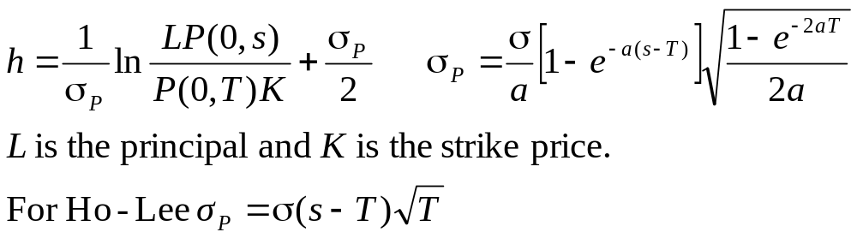
Options on Zero-Coupon Bonds (equation 32.10)
In Vasicek and Hull-White model, price of call maturing at T on a zero-coupon bond lasting to s is
LP(0,s)N(h)−KP(0,T)N(h−σ_{P})
Price of put is
KP(0,T)N(−h+σ_{P})−LP(0,s)N(h)
where

Slide 10
Options on Coupon-Bearing Bonds
In a one-factor model a European option on a coupon-bearing bond can be expressed as a portfolio of options on zero-coupon bonds.
We first calculate the critical interest rate at the option maturity for which the coupon-bearing bond price equals the strike price at maturity
The strike price for each zero-coupon bond is set equal to its value when the interest rate equals this critical value

Slide 11
Interest Rate Trees vs Stock Price Trees
The variable at each node in an interest rate tree is the Δt-period rate
Interest rate trees work similarly to stock price trees except that the discount rate used varies from node to node

Slide 12
Two-Step Tree Example (Figure 32.4)
Payoff after 2 years is max[100(r – 0.11), 0]
p_{u}=0.25; p_{m}=0.5; p_{d}=0.25; Time step=1yr
14% 3
12% 1.11*
12% 1
10%
0.35**
10% 0.23
10% 0
8% 0
8% 0.00
6% 0
*: (0.25×3 + 0.50×1 + 0.25×0)e^{–0.12×1}
**: (0.25×1.11 + 0.50×0.23 +0.25×0)e^{–0.10×1}

Slide 13
Alternative Branching Processes in a Trinomial Tree (Figure 32.5)
(a)
(b)
(c)

Slide 14
Procedure for Building Tree
dr = [θ(t ) – ar ]dt + σdz
1. Assume θ(t ) = 0 and r (0) = 0
2. Draw a trinomial tree for r to match the mean and standard deviation of the process for r
3. Determine θ(t ) one step at a time so that the tree matches the initial term structure

Slide 15
Example
σ = 0.01
a = 0.1
Δt = 1 year
Maturity | Zero Rate
0.5 | 3.430
1 | 3.824
1.5 | 4.183
2 | 4.512
2.5 | 4.812
3 | 5.086

Slide 16
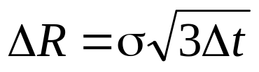
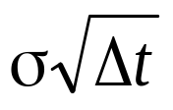
Building the First Tree for the Δt rate R
Set vertical spacing:
Change branching when j_{max} nodes from middle where j_{max} is smallest integer greater than 0.184/(aΔt)
Choose probabilities on branches so that mean change in R is -aRΔt and S.D. of change is

Slide 17
The First Tree
(Figure 32.6)
E
B
F
C
G
A
D
H
I
Node
A
B
C
D
E
F
G
H
I
R
0.000%
1.732%
0.000%
-1.732%
3.464%
1.732%
0.000%
-1.732%
-3.464%
p
u
0.1667
0.1217
0.1667
0.2217
0.8867
0.1217
0.1667
0.2217
0.0867
p
m
0.6666
0.6566
0.6666
0.6566
0.0266
0.6566
0.6666
0.6566
0.0266
p
d
0.1667
0.2217
0.1667
0.1217
0.0867
0.2217
0.1667
0.1217
0.8867

Slide 18
Shifting Nodes
Work forward through tree
Remember Q_{ij} the value of a derivative providing a $1 payoff at node j at time iΔt
Shift nodes at time iΔt by α_{i} so that the (i+1)Δt bond is correctly priced

Slide 19
The Final Tree
(Figure 31.7)
E
F
B
G
C
A
H
D
I
Node
A
B
C
D
E
F
G
H
I
R
3.824% 6.937%
5.205%
3.473%
9.716%
7.984%
6.252%
4.520%
2.788%
p
u
0.1667
0.1217
0.1667
0.2217
0.8867
0.1217
0.1667
0.2217
0.0867
p
m
0.6666
0.6566
0.6666
0.6566
0.0266
0.6566
0.6666
0.6566
0.0266
p
d
0.1667
0.2217
0.1667
0.1217
0.0867
0.2217
0.1667
0.1217
0.8867

Slide 20
Extensions
The tree building procedure can be extended to cover more general models of the form:
dƒ(r ) = [θ(t ) – a ƒ(r )]dt + σdz
We set x=f(r) and proceed similarly to before
x=ln(r) gives the Black-Karasinski model

Slide 21
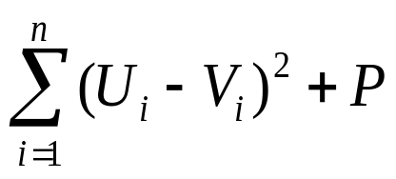
Calibration to Determine a and σ
The volatility parameters a and σ (perhaps functions of time) are chosen so that the model fits the prices of actively traded instruments such as caps and European swap options as closely as possible
We minimize a function of the form
where U_{i} is the market price of the ith calibrating instrument, V_{i} is the model price of the ith calibrating instrument and P is a function that penalizes big changes or curvature in a and σ

